Slide 1

LOAN PREDICTION MODEL
Under the Guidance of
Mrs G Sunitha Rekha
Assistant Professor
Team B1:
18B81A1236 Sandhya Adavikolanu
18B81A1247 Tarini Shekapuram
18B81A1248 Tejasree Belde

Slide 2
ABSTRACT
Due to the enhancement in the banking sector, lots of people are applying for bank loans but the bank has its limited assets which it has to grant to limited people only, so finding out to whom the loan can be granted which will be a safer option for the bank is a typical process. By predicting the loan defaulters, the bank can reduce its Non- Performing Assets. So, this can be done by selecting the safe person so as to save lots of bank efforts and assets. Loan Prediction is very helpful for employee of banks as well as for the applicant also. The applicant can also predict whether he can borrow from a particular bank based on certain input parameters. This is done by analysing the previous records of the people using the machine learning model which give the most accurate result .The Loan Prediction System can automatically predict using certain parameters that are taking part in loan processing and on new test data same features are processed with respect to their associated weight .It can be used to check whether the applicant loan can be sanctioned or not.

Slide 3
INTRODUCTION
What and Who faces this problem?
Loan Approval is an important process for banks. People get loan from banks ; however, it may be baffling for the bankers to judge who can pay the loan back nevertheless the bank shouldn’t be in loss since banks earn most of the profit from loan sanctioning
Why should this problem be solved?
Banks pass loan after completing the numerous verification processes despite all these , it is still not confirmed that borrower will pay back the loan or not
Our approach to solve the problem
We plan to use different types classification and prediction algorithms to find out which algorithm gives better accuracy. Finally our system approves or rejects the loan applications. We plan to integrate this ML model with a Webapp.

Slide 4
LITERATURE REVIEW AND LIMITATIONS OF EXISTING WORK
Machine learning helps to learn data from its own experience and in prediction and decision of data. It has brought the revolution in the field of computer science because data is the most important thing in the world. To analyze data, Machine Learning has given many solutions by its algorithms. We have gone through many papers before beginning to develop this model to collect information . In one of the approaches data was collected and pre-processed, applied to the ML models, training followed by testing the data. During the pre-processing stage, the detection and removal of outliers and imputation removal processing were carried out. In the present method, SVM, DT, KNN and gradient boosting models were employed to predict the possibilities of current status regarding the loan approval process. The conventional 80:20 rule was adopted to split the dataset into training and testing processes. Experimentation concluded that, DT has significantly higher loan prediction accuracy than the other models.

Slide 5
CONTD…
In another approach data mining was used to develop a model and the system has 3 components- preprocessing, classification and database updation . KNN, Binning and naïve-bayesian algorithm was used for prediction model. Similarly one more solution was to use classifier technique in which combination of min-max normalization and KNN algorithm is used which gives 75.08% accuracy result. R programming language is used to build KNN soring credit model. This paper focuses on predicting the loan status in commercial banks.The existing models are using KNN or Naïve bayesian Classifiers which have an accuracy ranging 75-80%.We will be using decision tree whose accuracy rate is greater than these existing models.

Slide 6
Software Requirement Specification with functional and non-functional requirements
TECHNOLOGY STACK
1.Front End:
HTML, CSS, Bootstrap, Java Script
2.Back End:
Decision Tree Algorithm(Classification Problems),Pandas Library, Matplotlib Library, Numpy Library from Python , Flask, Loan prediction data set (Kaggle),The Logistic regression prediction model(ML).

Slide 7
FUNCTIONAL REQUIREMENTS
1. User should be able to register with our platform if he does not have an account
2.User should be able to login to our platform if he has an account
3.User should be able to change his/her password whenever needed
4.User should be able to enter details to calculate EMI
5.User should be able to enter details to predict their loan eligibility
NON-FUNCTIONAL REQUIREMENTS
The non-functional requirements of the Loan automation application software include:
Portability -Access from various software and hardware platforms, and deployment to various hardware platforms and can be integrated with any bank application
Efficiency -Loan contents managed efficiently and content structure well organized and precisely represents the system; interface concise and precise for all users
Security -Identities of each registered client kept private each registered client logs-in with username and password; without appropriate permissions, clients cannot access any data in the system

Slide 8
Problem Statement
Loans are the core business of banks. The main profit comes directly from the loan’s interest. These banks deal with all kinds of loans. They have presence across all urban, semi urban and rural areas. Customer first applies for the loan after that bank validates the customer’s eligibility for loan. However doing this manually takes a lot of time. Therefore we can automate the loan eligibility process (real time) based on customer information. The banks grant a loan after an intensive process of verification and validation.
Banks would give loans to only those customers who are eligible so that they can be assured of getting the money back. Hence the more accurate we are in predicting the eligible customers the more beneficial it would be for the bank . The main aim of this use-case is to build a predictive model to predict if an applicant is able to repay the lending bank or not.

Slide 9
Configuration of Hardware and Software requirements
HARDWARE :
Core i5 processor
At least 8GB RAM
At least 60GB of Usable Hard Disk Space
SOFTWARE :
Python 3
Anaconda Distribution
Jupyter Notebook
Pandas package
NuMpy package
MACHINE LEARNING ALGORITHM(DECISION TREE ALGORITHM)

Slide 10
Modules
1.Data Collection
We collected the bank-dataset from Kaggle in the form of .csv files
2. Data preprocessing
Data Preprocessing includes data cleaning, data integration ,data transformation , data reduction Any inconsistencies ,errors , missing values , null values are identified and removed. Any attributes which does not contribute to the prediction are eliminated. The attributes in the nominal format are converted into numeric or binary format. We will make use of Pandas and Numpy libraries from pyhton for data analysis and manipulation
3.Data visualization
Graphs will be plotted to represent the preprocessed data. We will make use of matplotlib library from python to construct histogram plot , scatter plot , BOX PLOT, error charts , pie charts.

Slide 11
5.Building Block
We will make use of decision tree algorithm for training the data and logistic regression for predicting the loan eligibility.
6.WEBSITE BULIDING
We will design a WebApp which consists of login , registration , EMI calculator and for displaying the predicted loan eligibility output. We will create the webpages using HTML , CSS , BOOTSTRAP , JavaScript . We will finally integrate our ML model with the WebApp using Python and Flask.

Slide 12

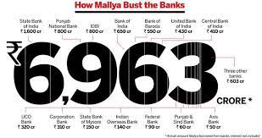
MOTIVATION
The loan is one of the most important products of the banking and one of the major revenue generation for banks . But loan repayment is a difficult task to track and this issue has been persistent since many years although many models have been developed over the years to address this issue , they haven’t produced much accurate results. There have been many frauds worth crores of rupees which ultimately resulted in the loss of trust on banks and lead to decline of Indian Economy. We want to ensure that these frauds are not repeated in future and people’s hard earned money should not be at stake. This is what motivated us to take up this project.

Slide 13
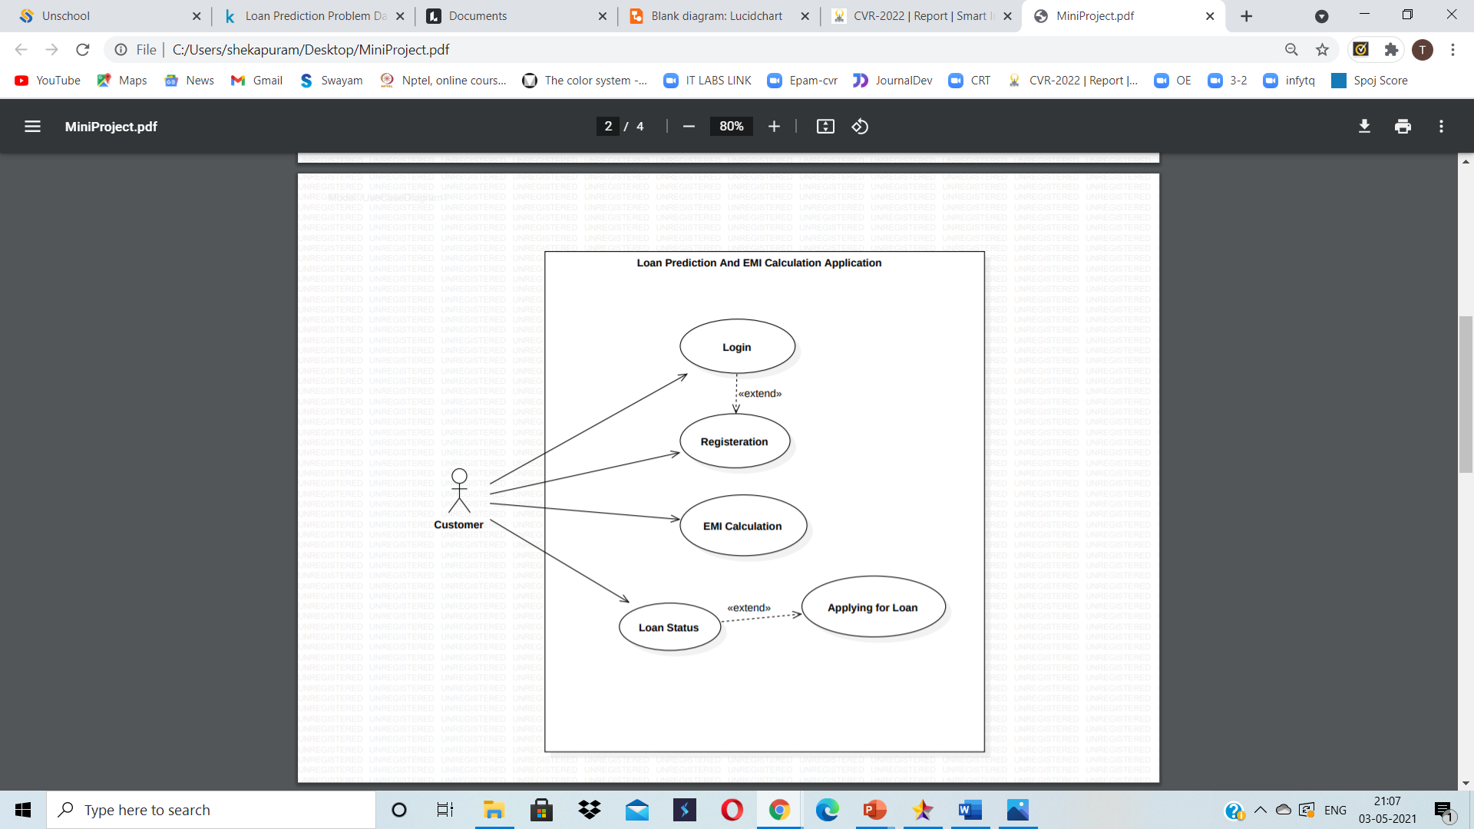
USE CASE DIAGRAM

Slide 14
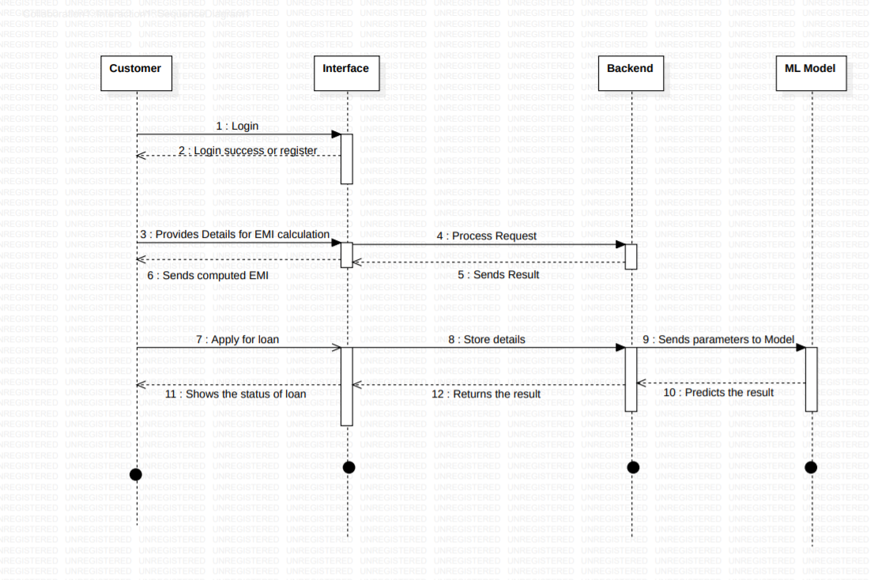
SEQUENCE DIAGRAM

Slide 15
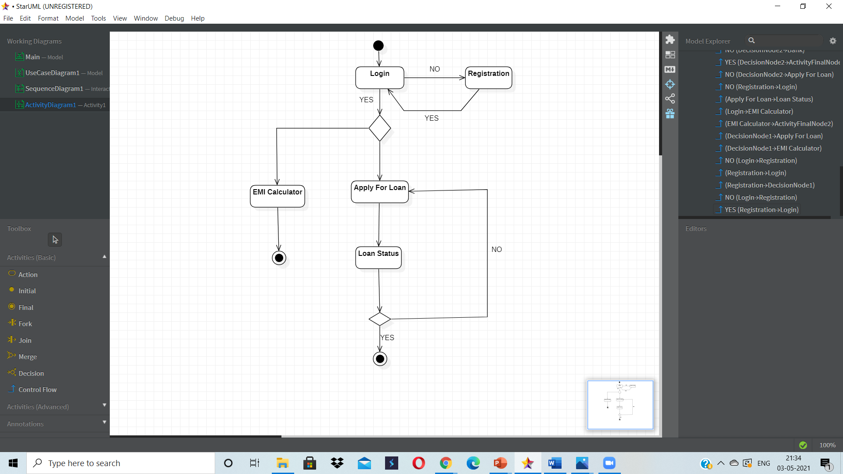
ACTIVITY DIAGRAM

Slide 16
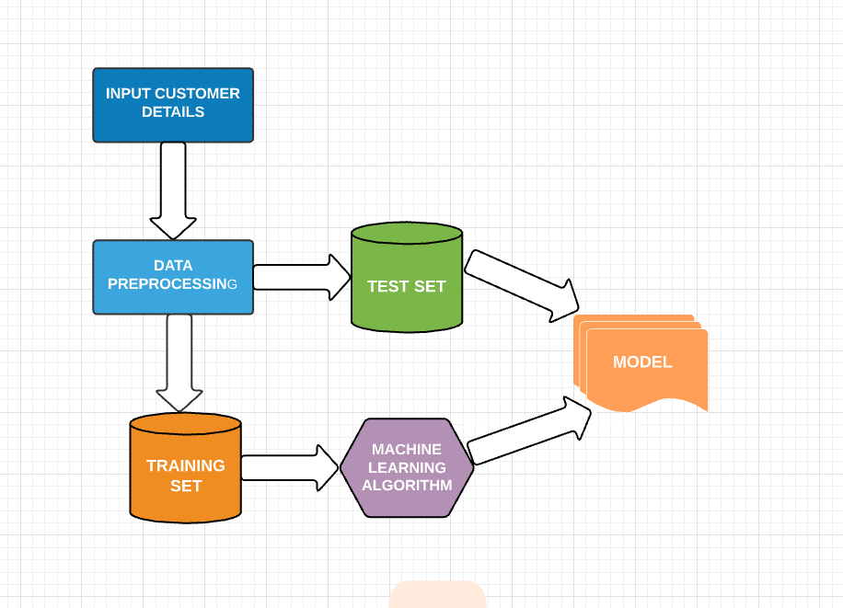
ARCHITECTURE DIAGRAM

Slide 17
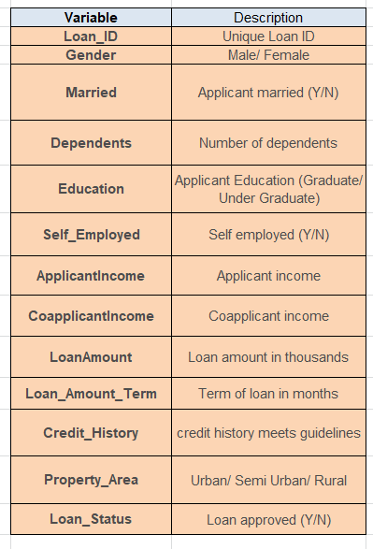
DATASET DESCRIPTION
DataSet Link:
https://www.kaggle.com/altruistdelhite04/loan-prediction-problem-dataset
Number of tuples: 367
Algorithms :
1.Decision Tree
2.KNN
3.Logistic Regression

Slide 18
REFERENCES
Prediction of Loan Approval using Machine Learning Technique [1] Sourav Kumar, [2] Amit Kumar Goel [1][2] Galgotias University, Greater Noida, India , International Journal of Advanced Science and Technology Vol. 29, No. 6s, (2020), pp. 4152 – 4161
Predictive and probabilistic approach using logistic regression: Application to prediction of loan approval by ASHLESHA VAIDYA ,IEEE PUBLISHER , Published in: 2017 8th International Conference on Computing, Communication and Networking Technologies (ICCCNT)
LOAN APPROVAL PREDICTION BASED ON MACHINE LEARNING Deepak Ishwar Gouda1, Ashok Kumar A2, Anil Manjunatha Madivala3, Dilip Kumar R4, Dr.Ravikumar5 1,2,3,4B.E. Student, Department of CSE, Sir M Visvesvaraya Institute of Technology, VTU, Bengaluru, Associate Professor.
Algorithm & module reference for Azure Machine Learning designer

Slide 19
“Safe Loans Leads To Flourished Nation…”
Thank You

